Slide 1

STOCK VALUE PREDICTION USING MACHINE LEARNING
Submitted by:- AMAN KAUSHIK
University roll no.:- 2018662
BTECH(CSE)
SEC - C
MENTOR – Dr. Sharon Christa

Slide 2
INTRODUCTION
Stock markets can be defined as dynamic, unpredictable, non-linear, and highly volatile in nature. Stock price predictions are very important among many business people and retail investors. Predicting stock market prices is a difficult and challenging task as they are complex and diverse and it depends on various economic factors like economic uncertainty, company’s financial reports and performance and price indicator as well as non-economic factors such as political conditions, and investor’s expectations, etc. The prices of stocks are mainly governed by demand and supply, and the ultimate goal of buying shares is to make money by buying stocks in companies whose share price is expected to jump up .
There are two common methods of attempting to forecast stock prices of an organization. The first is fundamental analysis, which considers external factors like company profile, market situation, political and economic factors, textual information in the form of financial news articles, social media and even blogs by economic investigators. The second is technical analysis, that attempts to find patterns in charts and use past price trends of stocks like closing and opening price, volume traded, adjacent close values and many more, to predict future price action. Nowadays, for predicting stock prices, advanced intelligent techniques based on either technical or fundamental analysis are used.

Slide 3
Based on the data of historical stocks the stock price can be predicted. The most promising and prominent technique involves the use of Recurrent Neural Networks (RNN), that is basically the implementation of machine learning. Machine learning has been widely used in the capital market and plays a major role in predicting future stock prices based on historical data. Machine learning involves artificial intelligence which empowers the system to learn and improve from past experiences without being programmed time and again, thereby increasing the accuracy .
The proposed approach considers the available historic data of a particular share, and it provides predictions on a particular feature. In order to predict a share price for a required time period, the proposed model uses the time series analysis. This model applies a type of recurrent neural network (RNN) capable of addressing linear problems and predicting time series- Long Short Term Memory (LSTM) networks. LSTM is a deep learning technique. Long-term Memory (LSTM) units execute very long sequences. LSTM evaluates the time series data by using both the historical and the present stock data accurately. LSTM replaces the traditional artificial neurons in the network layer into the most useful memory cells. With these memory cells, networks are able toassociate memory with remote input over time. Over the past few years, LSTM has been applied to stock market prediction in different stock markets around the world.

Slide 4
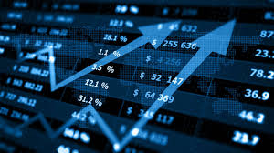
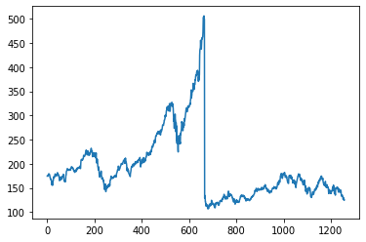
PROBLEM STATEMENT
Time Series forecasting & modelling plays an important role in data analysis. Time series analysis is a specialized branch of statistics used extensively in fields such as Econometrics & Operation Research. Time Series is being widely used in analytics & data science. Stock prices are volatile in nature and price depends on various factors. The main aim of this project is to predict stock prices using Long short-term memory (LSTM).

Slide 5
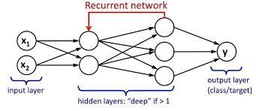
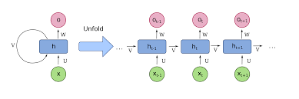
METHODOLOGY
Recurrent Neural Network(RNN):
A recurrent neural network (RNN) is a type of artificial neural network which uses chronological data or time series data. Recurrent neural networks utilize training data for knowledge. They are distinguished by their “memory” as they take information from previous inputs to influence the current input and output. On the other hand, traditional neural networks assume that inputs and outcomes are not related to each other, the output of the recurrent network depends on the prior attributes within the sequence. The main and most important feature of RNN is Hidden state, which can remember some data about a sequence.

Slide 6
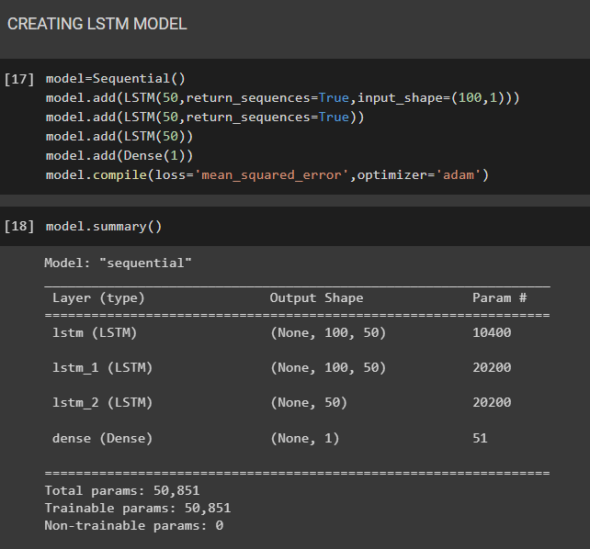
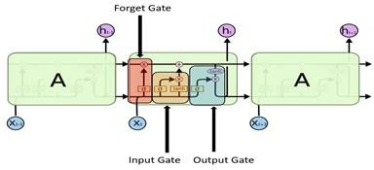
- Long-Short Term Memory(LSTM):
The LSTM is a special kind of RNNs due to its ability to memorize sequences of data. It contains information in memory, similar to computer memory. This memory can be seen as a closed group of cells, with a closed description, the cell decides to store or remove information. Each node in LSTM consists of a set of cells which are responsible for storing data streams that have passed, in each individual cell there is the upper line which connects the models as a transport line carrying the data from the past to the present ones, the independence of cells helps the model dispose of filters or add values of a cell to another. At last, the sigmoidal neural network (SNN) layer composing the gates drive the cell to an optimal value by disposing or letting data pass through.

Slide 7
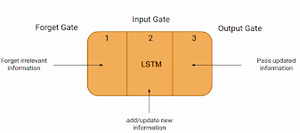
GATES IN LSTM
There are three gates in LSTM: input, forget and exit gate. These gates determine whether new input should be allowed, data deleted because it is not important, or allow it to affect output at current timeline.
Forget Gate: It determines when certain parts of the cell will be inserted with data that is most recent. It subtracts 1 in parts of the cell state to be kept, and 0 in values to be ignored.
Input Gate: Based on the input, this network category reads the conditions under which information should be stored or updated in the state cell.
Output Gate: Depending on the input mode and the cell, this gate determines which information is forwarded in the next location in the network.

Slide 8
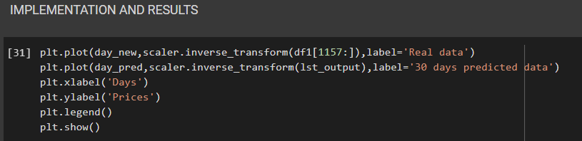

IMPLEMENTATION AND RESULTS:
The implementation of proposed system using LSTM model using python shows the prediction of the future price of TESLA share based on its historical data. The below visualization scatter plot figure shows the visualization of TESLA prediction. In the result shown in the below graph is the plotted form our algorithm outcome by applying LSTM for achieving the accuracy.

Slide 9
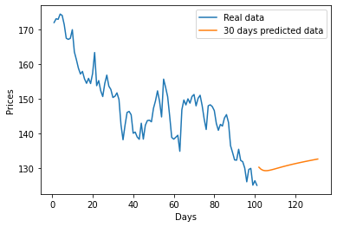
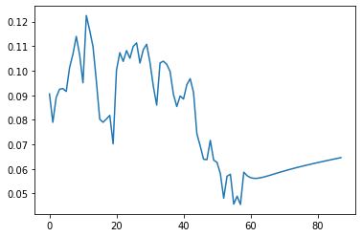
DAYS PREDICTED DATA
REAL DATA VS 30 DAYS PREDICTED DATA

Slide 10
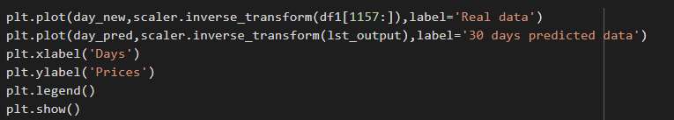


CONCLUSION
Predicting the stock market is a time-consuming and strenuous procedure. However, with the introduction to Machine Learning and its various algorithms, the Stock Market Prediction advancements have begun to include such approaches in analyzing stock market data. By measuring the accuracy of the different algorithms, we found that the most suitable algorithm for predicting the market price of a stock based on various data points from the historical data is the Long-Short Term Memory (LSTM) algorithm.

